Slide 2
Active Communication for Democratic Citizenship

Slide 3
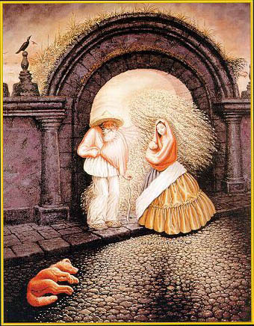

Slide 6
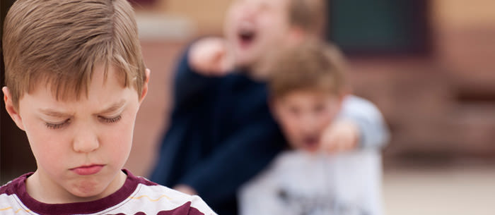

Slide 7
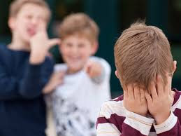

Slide 8
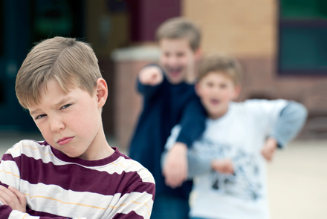

Slide 9
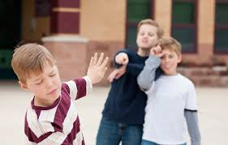

Slide 10
What do you think has happened?
What would you do if you were at a similar situation?

Slide 11
“I Message”
I feel …….
Tell the other person how you feel
When you…
Describe the event that caused your feelings
Can you please…
Tell what you would like to happen in the future

Slide 12
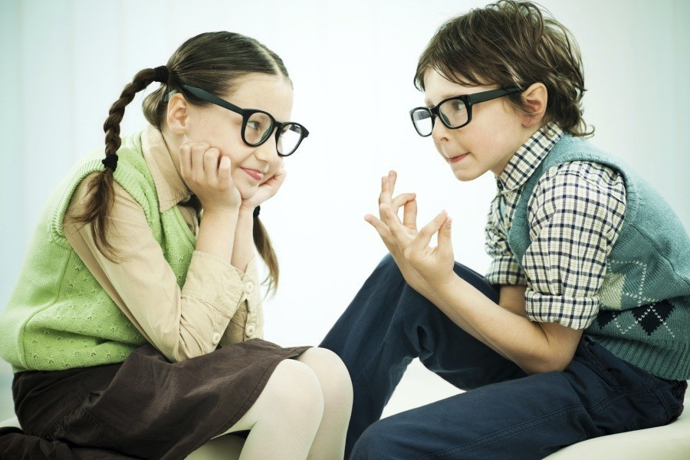
Do they talk between each other… while they are keeping silent?

